Slide 1



IPW Simulation 2
Department of Biostatistics and Bioinformatics,
Duke University
December 12, 2017

Slide 2
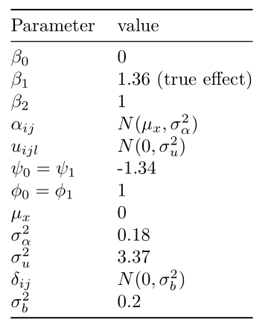
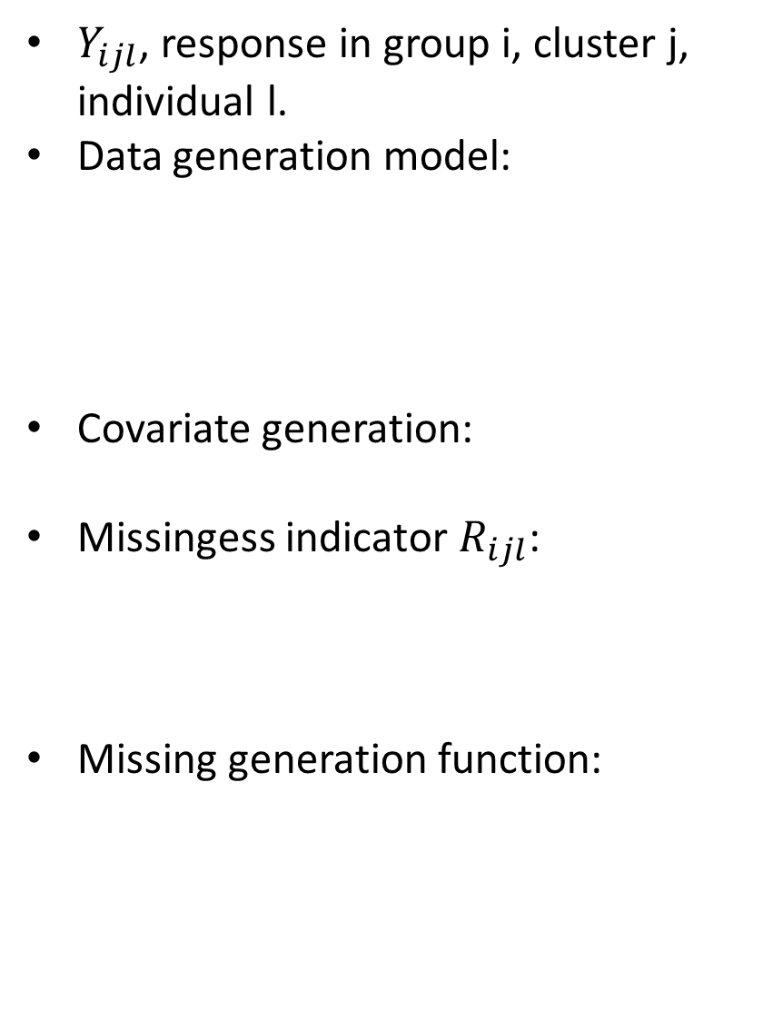

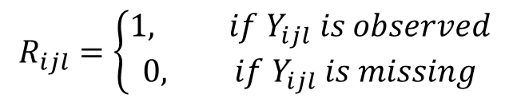




Covariates values
$Y_{ijl}$, response in group i, cluster j, individual l.
Data generation model:
Covariate generation:
Missingess indicator $R_{ijl}$:
Missing generation function:
$$π_{ijl}=exp(β_{0}+β_{1}i+f_{i}\left(X_{ijl}\right)+δ_{ij})$$
$$f_{i}\left(X_{ijl}\right)=β_{2}X_{ijl}$$
$$Y_{ijl} ∼Bin(1,π_{ijl})$$
$$X_{ijl}=α_{ijl}+u_{ijl}$$
$$R_{ijl}=\left\{\begin{aligned}1, if Y_{ijl} is observed \\ 0, if Y_{ijl} is missing\end{aligned}\right.$$
${logit(R}_{ijl}=0|Y_{ijl, }X_{ijl}$)=$ψ_{i}+φ_{i}X_{ijl}$

Slide 3
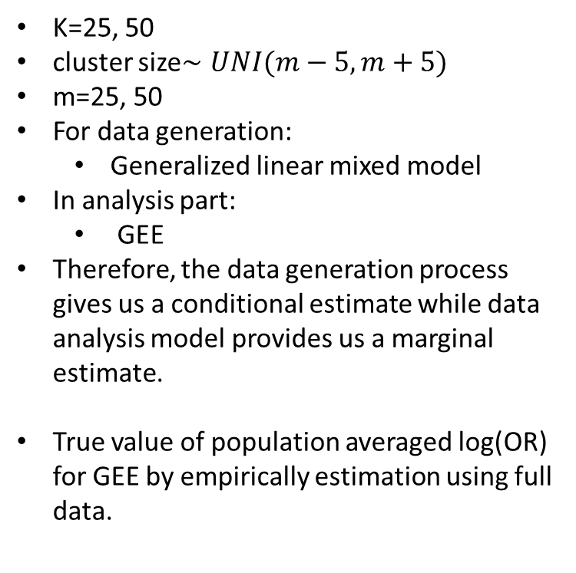
Covariates values
K=25, 50
cluster size$∼UNI(m−5, m+5)$
m=25, 50
For data generation:
Generalized linear mixed model
In analysis part:
GEE
Therefore, the data generation process gives us a conditional estimate while data analysis model provides us a marginal estimate.
True value of population averaged log(OR) for GEE by empirically estimation using full data.

Slide 4
Missingness Handling Methods
Complete Record Analysis
Unadjusted
Adjusted
Inverse Probability Weighting (IPW):
IPW with no cluster effect: lmer+geepack
IPW with no cluster effect: CRTgeeDR
IPW with cluster effect: lmer+geepack
IPW with cluster effect: CRTgeeDR
Multilevel Multiple Imputation (MMI)
$$\operatorname{logit}\left(π_{ijl}\right)=β_{0}^{∗}+β_{1}^{∗}ARM$$
$\operatorname{logit}\left(π_{ijl}\right)=β_{0}^{∗}+β_{1}^{∗}ARM$+$β_{2}^{∗}X_{ijl}$

Slide 5
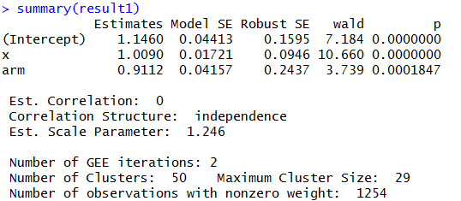
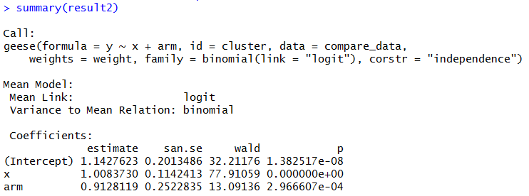
Check one dataset to compare CRTgeeDR and lme4+geekpack
CRTgeeDR
lme4
geepack

Slide 6
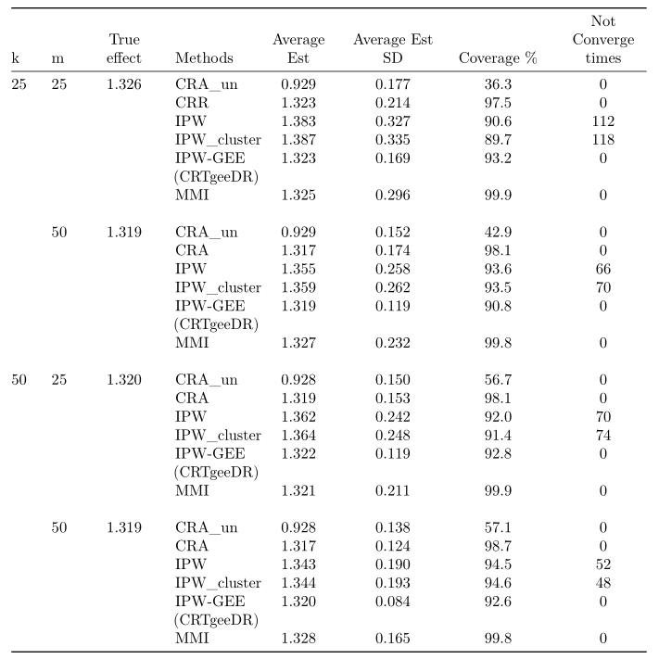
Last time results
Weight calculation
Weight outliers
Non-convergence time
Difference between geepack and CRTgeeDR
CRTgeeDR under-converage
Notes:
Mmi no biase increasing variance

Slide 7
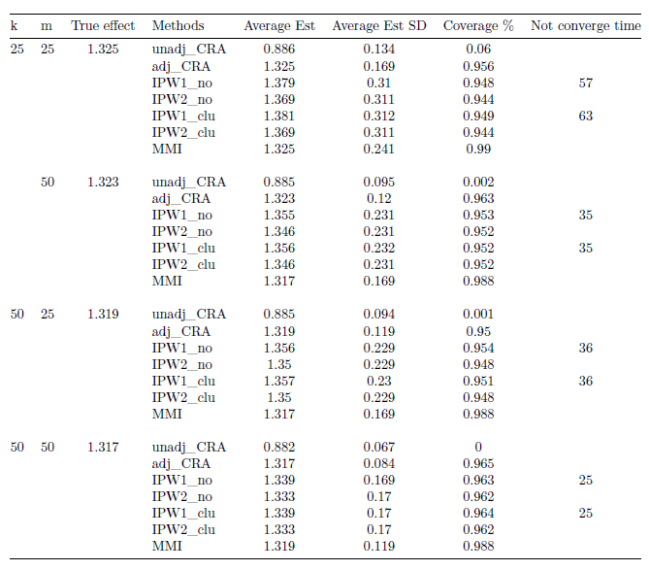
Simulation Results
• unadj_CRA: unadjusted Complete Record Analysis
• adj_CRA: adjusted Complete Record Analysis
• IPW1_no: without cluster effect IPW, using glm+geese
• IPW2_no: without cluster effect IPW, using CRTgeeDR
• IPW1_clu: with cluster effect IPW, using glm+geese
• IPW2_clu: with cluster effect IPW, using CRTgeeDR
• MMI multilevle multiple imputation
Notes:
True effect: 1.325, 1.323, 1.319, 1.317
Small cluster number
0. add MI, standard MI.
Mat calro MC sd, ESTIMATED sd/ SD of the estimate.
1. Exchangable
2. Add clustering
Missingness interaction missing function x, x+arm, (x*arm) / + cluster
Mmi, geepack, CRTgeeDR.
Truncating based on missing percentage. Not weight itself
### Logit 可能很小了，change parameter， 0.001
Add everything to the then do exchangeable
Not round the weight
Do ICC, 0.1 0.5

Slide 8
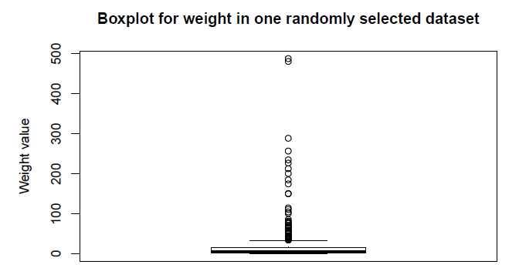
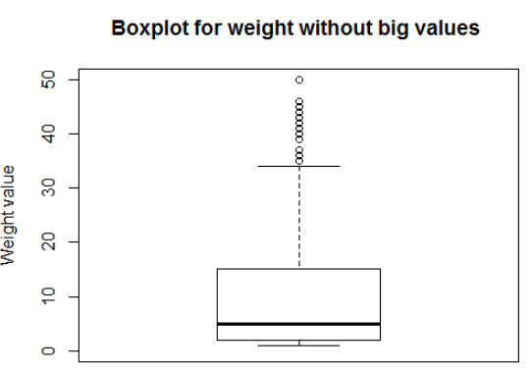
Check the weight

Slide 9
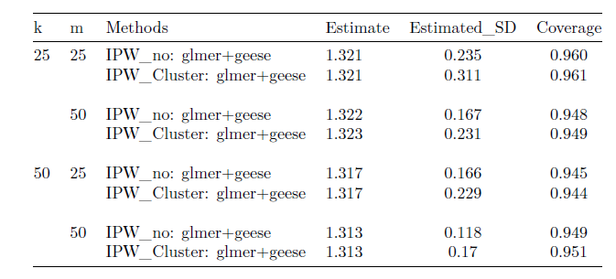
Results after delete weight outliers
True effect: 1.325, 1.323, 1.319, 1.317
Notes:
4.1
Section 4.1

Slide 10
Thank You!

Slide 11
Notes:
Is that missing percentage matter a lot? Since when I add x and arm it change and the beta for arm and x*arm
Coefficient how to choose

